Slide 1

employee payroll Management System
226 AK Batch
Group 2

Slide 2

226 AK Batch Group -02
Team Members
Ayush Aggarwal 2528480
Ayush Sharma 2525809
Bacham Sumanth Reddy 2528883
Bavadharani M P 2528050
Bhavanam Tarun Kumar Reddy 2527499
Bhumireddy Kondareddy 2526885
Burugupalli Sharmila 2528792
Chamanthula Uma Lakshmi 2527434
Chandu Sai Suresh Krishna 2528728
Cheelasani Pavan Kumar 2529084

Slide 3
Contents
Overview
App Flow
Tools & Languages Used
System Requirements
Output
Conclusion

Slide 4
Overview
Employee payroll management system is an Internet-based Java application that automates the working of a company or work center that manage and maintain records of the employees in the different departments.
The proposed project “Employee Payroll Management System” has been developed to overcome the problems faced in the practicing of manual system.
This web application is reduced as much as possible to avoid errors while entering data. It also provides error message while entering invalid data.

Slide 5
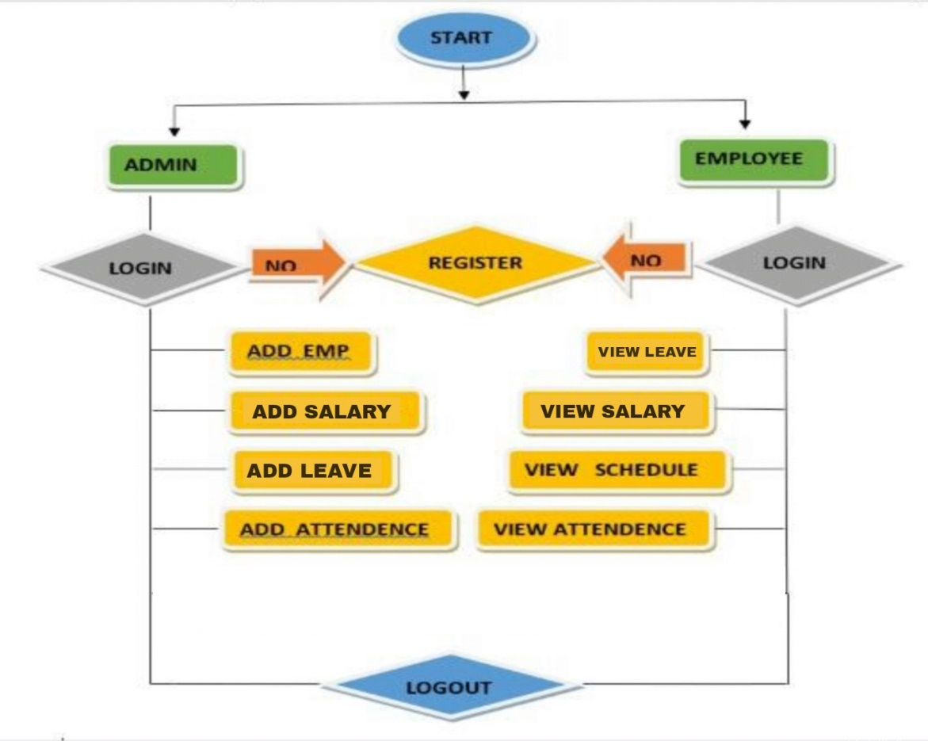
App Flow

Slide 6
Tools & Languages
Front End
Back End
Visual Studio
Angular
HTML
CSS
BOOTSTRAP
TYPESCRIPT
Eclipse
Spring Tool Suite
MySQL
Hibernate , JPA
Rest API

Slide 7

System Requirements
Visual Studio, Eclipse, Postman and MySQL to be installed to the system.
4 GB Random Access Memory.
800 MB of Free Space on Hard Disk.
Microsoft Windows XP or Linux or Equivalent OS.
Web Browser.

Slide 8
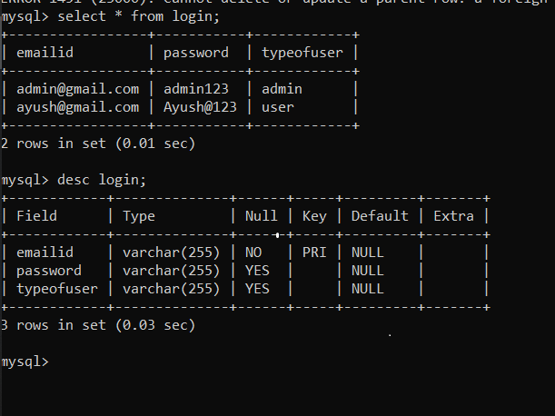
SignUp Table

Slide 9
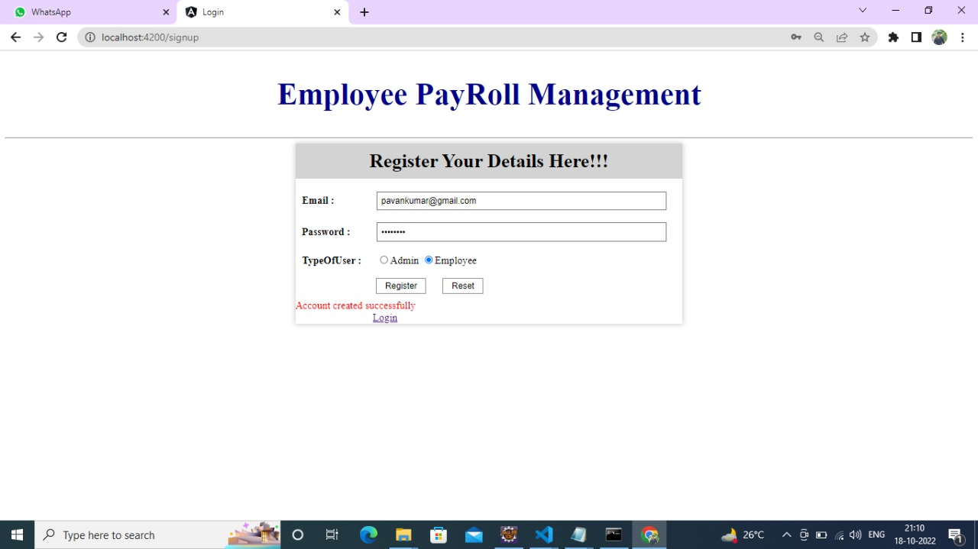
Registraton Portal for Employee
Outputs

Slide 10
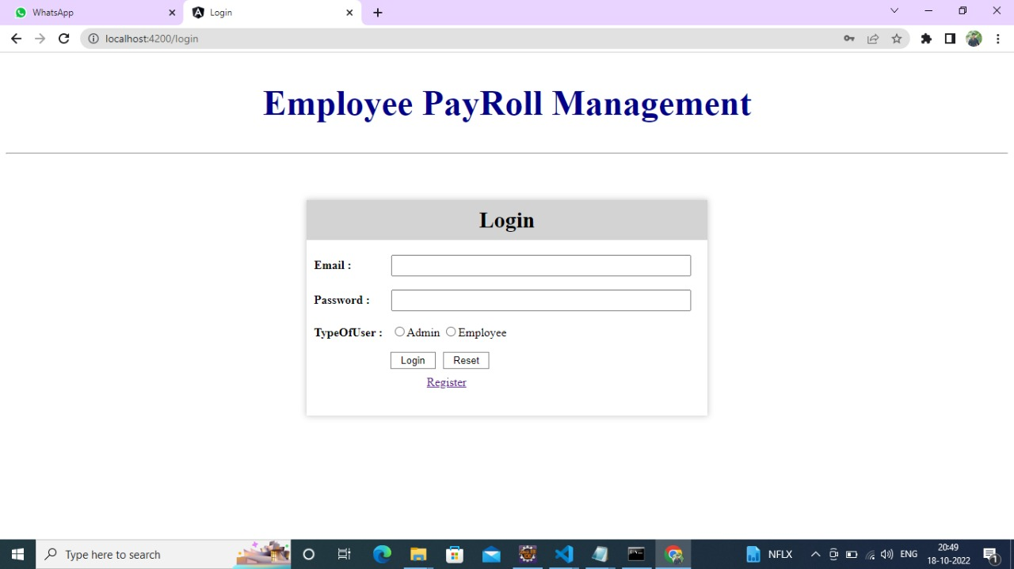
Login Portal for Admin/Employee

Slide 11
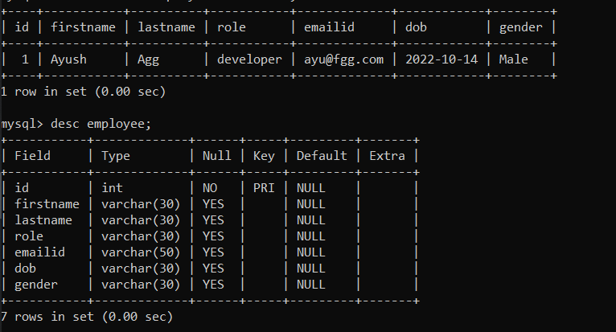
Employee Table

Slide 12
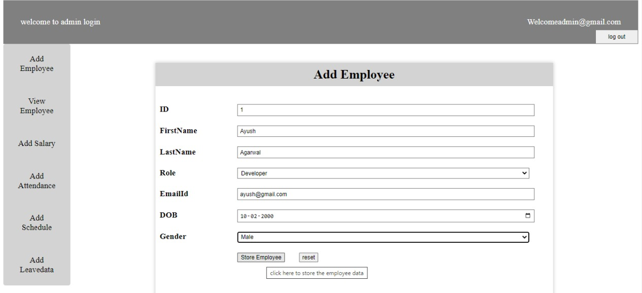
Admin Functionalities
Adding Employee Details

Slide 13
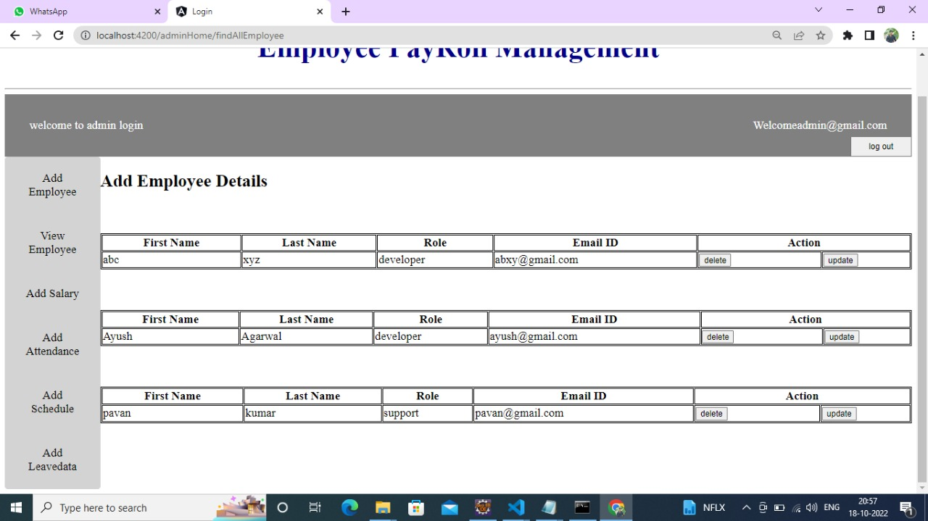
Admin Functionalities
View Details of All Employees

Slide 14
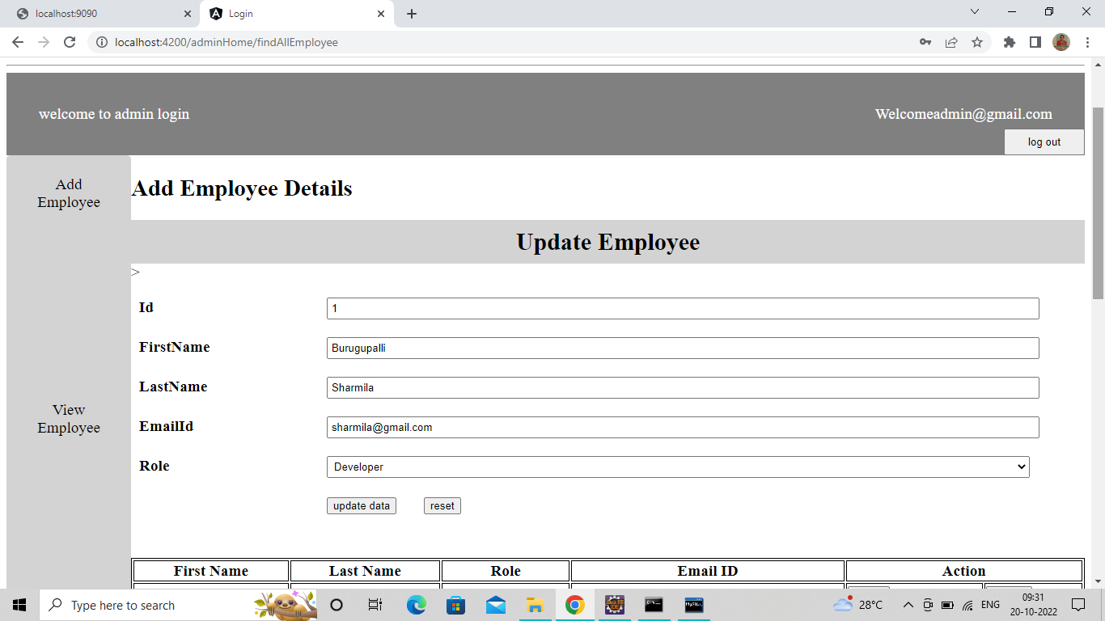
Admin Functionalities
Update Details of All Employees

Slide 15
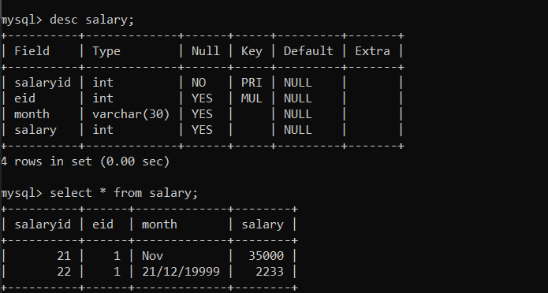
Salary Table

Slide 16
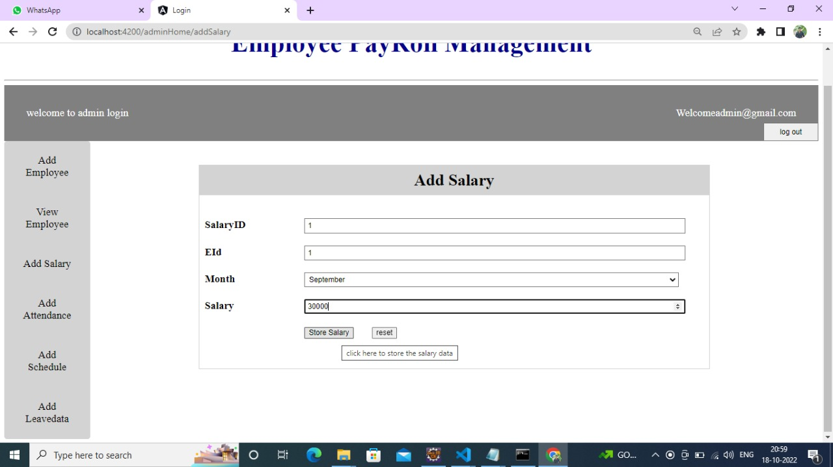
Admin Functionalities
Adding Salary Details of Particular Employee

Slide 17
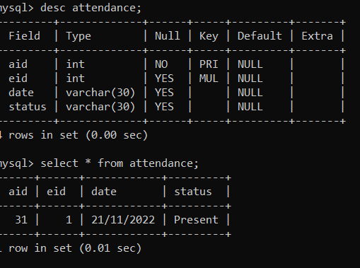
Attendance Table

Slide 18

Admin Functionality
Adding Attendance Details of Particular Employee

Slide 19
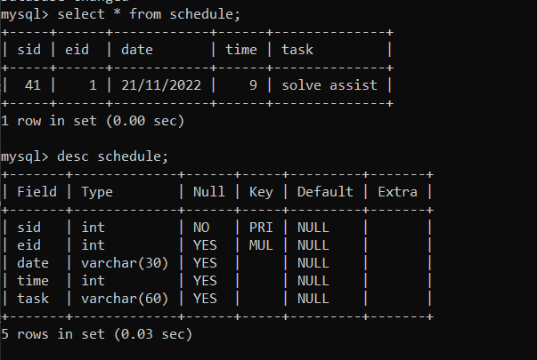
Schedule Table

Slide 20
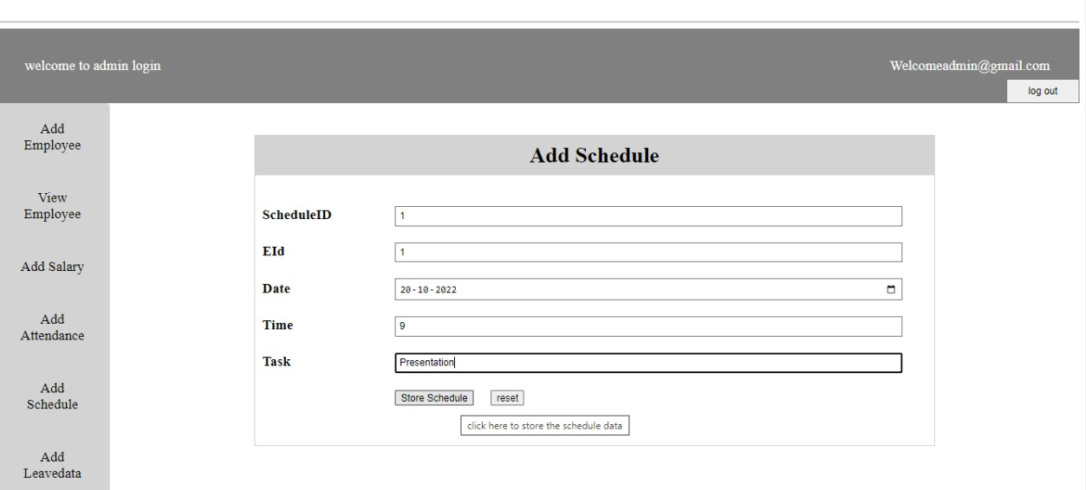
Admin Functionalities
Adding Schedule Details of a Particular Employee

Slide 21
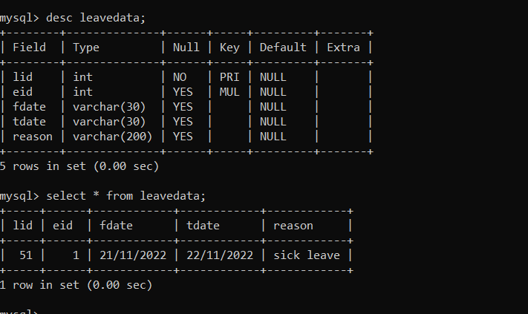
Leave Table

Slide 22

Admin Functionalities Adding Leave Details of a Particular Employee

Slide 23
Registration Portal For Employee

Slide 24
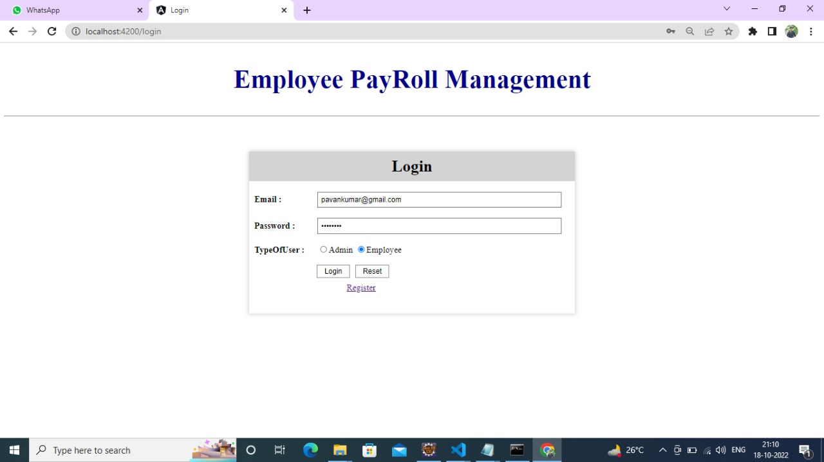
Login Portal for Employee

Slide 25
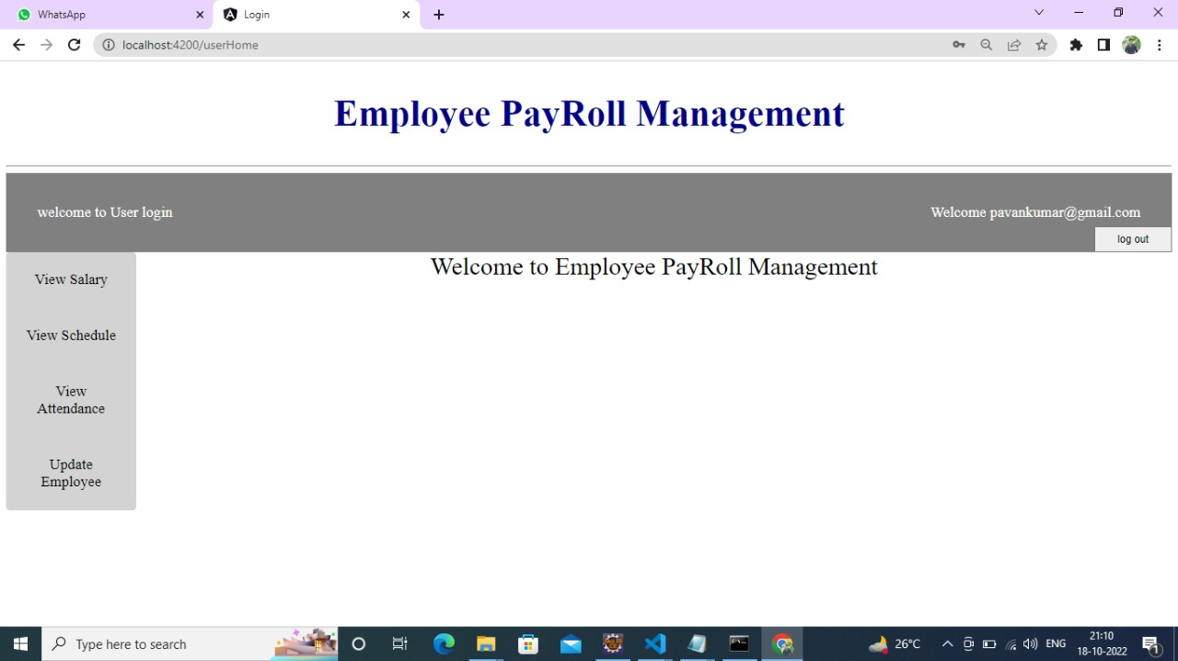
User Dashboard

Slide 26
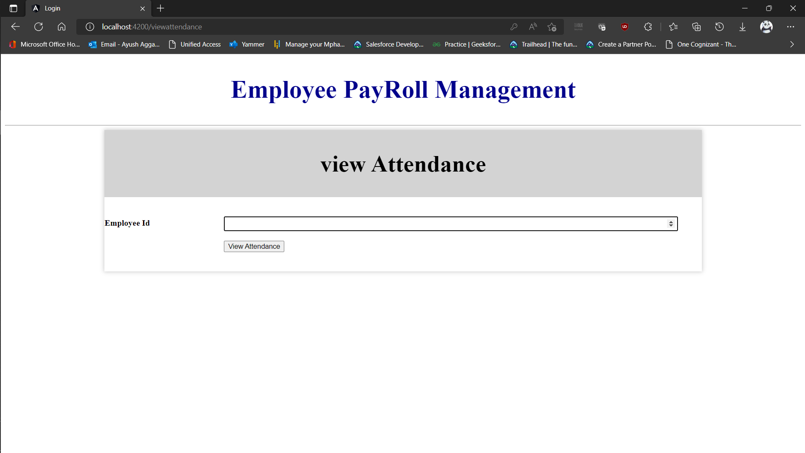
User Functionalities View Attendance Details of that Employee

Slide 27
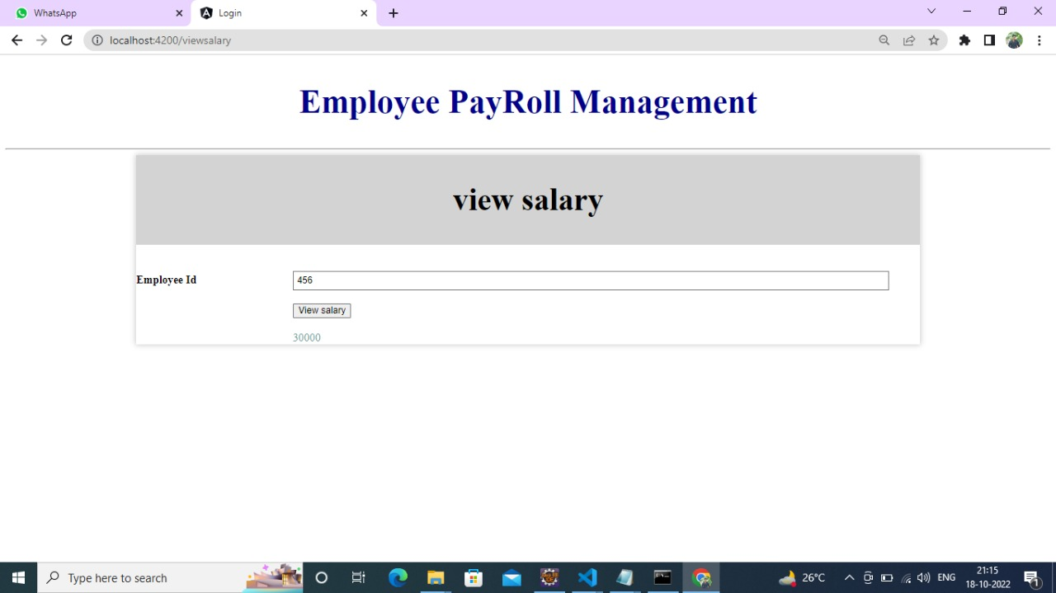
User Functionalities View Salary Details of that Employee

Slide 28
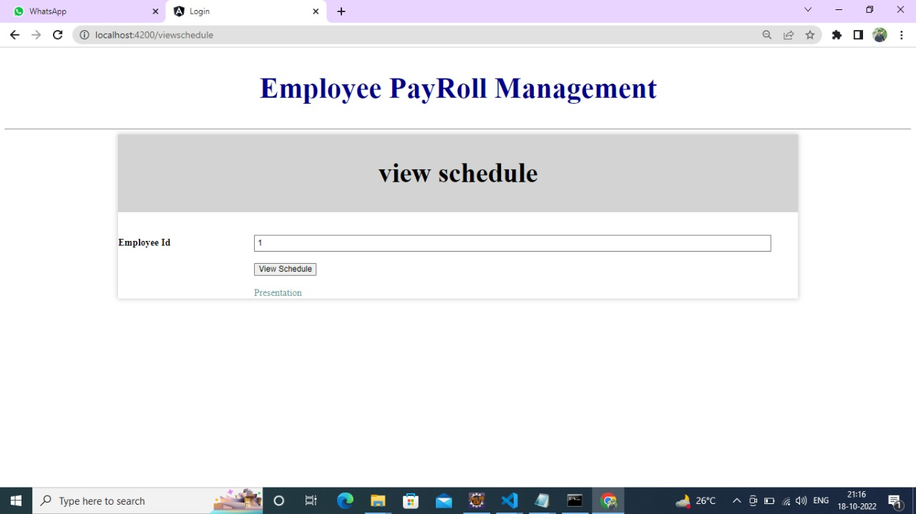
User Functionalities View Schedule Assigned to that Employee

Slide 29
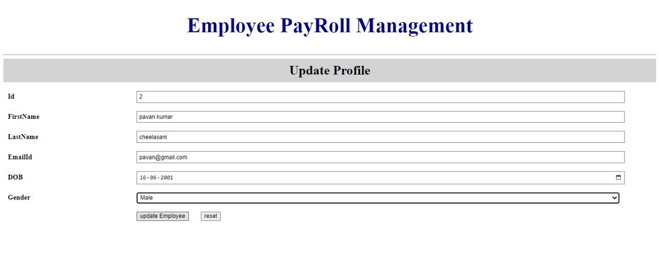
User Functionalities Update Profile of that Employee

Slide 30
Testing(Test NG)
TestNG provides full control over the test cases and the execution of the test cases. Due to this reason, TestNG is also known as a testing framework.
TestNG framework came after Junit, and TestNG framework adds more powerful functionality and easier to use.
TestNG framework eliminates the limitations of the older framework by providing more powerful and flexible test cases with help of easy annotations, grouping, sequencing and parametrizing.

Slide 31
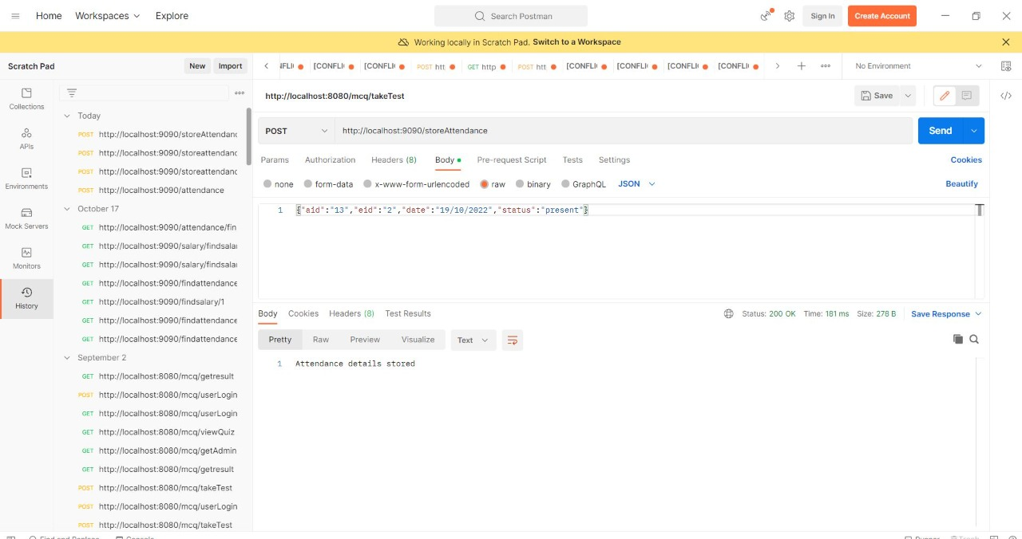
Testing(Rest Client)

Slide 32
Conclusion
This project is built keeping in mind that it is to use by admin and the employees in an organization . It is built for use in small scale organization where the number of employees is limited. According to the requested requirement the admin can add, manipulate, update and delete all employee data in his organization. The admin can add new Employee and delete them. The Admin can also add predefined pay grades for the employees. The required records can be easily viewed by the admin anytime time he wants in an instant. The payment of the employee is based on monthly basis. Numerous validations implemented would enable the admin to enter accurate data. The main objective of this framework is to save time, make the system cost effective and management records efficiently.

Slide 33

THANK YOU

